Slide 1

Faculty Contribution Management System
Developed by : Tushar kumar

Slide 2

Team Leader : Tushar Kumar
Team Member : Tushar kumar
Projct Supervisor : Dr.Akash Rajak

Slide 3

INTRODUCTION
The Faculty Contribution Management System (FCMS) is a comprehensive software solution designed to streamline and enhance the management of faculty contributions in educational institutions. This system addresses the need for efficient tracking, assessment, and recognition of faculty members' academic, research, and administrative contributions. FCMS aims to empower institutions to effectively manage and leverage the expertise and contributions of their faculty members, ultimately fostering a culture of continuous improvement and excellence.
The FCMS is a pioneering software solution designed to revolutionize the way educational institutions track, assess, and harness the diverse contributions of their faculty members.

Slide 4
Technologies / Software Requirements
The software requirements for a Faculty Contribution Management System (FCMS) project will depend on the specific technology stack chosen for development. However, here is a general list of software requirements that are typically needed for such a project:
Operating System (OS):
Depending on the technology stack, the project may require server operating systems (e.g., Linux, Windows Server) for hosting the FCMS and client operating systems (e.g., Windows, macOS) for user access.
Web Development Frameworks:
Frameworks such as Ruby on Rails, Django, Laravel, or Express.js may be used for building the web-based user interfaces and back-end logic of the FCMS.

Slide 5
Database Management System (DBMS):
Choose a relational database management system (e.g., PostgreSQL, MySQL, Oracle) or a NoSQL database (e.g., MongoDB) for storing and managing faculty contribution data.
Programming Languages:
Depending on the chosen framework, programming languages like Python, Ruby, PHP, Node.js, or Java may be required for development.
Integrated Development Environment (IDE):
Developers will need appropriate IDEs such as Visual Studio Code, PyCharm, or Eclipse for coding, debugging, and testing.
Front-End Technologies: For building the user interfaces, technologies like HTML, CSS, JavaScript (or front-end frameworks like React, Angular, or Vue.js) are essential.
Back-End Technologies: Back-end logic may require scripting languages (e.g., Python, Ruby), server-side frameworks,
and middleware components.

Slide 6
Hardware requirements / Hardware Used
The hardware requirements for a Faculty Contribution Management System (FCMS) can vary depending on the scale and complexity of the system, as well as the number of users it needs to support. Here are some general hardware requirements to consider when planning for an FCMS project:
Server Hardware:
Processor: A modern multi-core processor (e.g., Intel Xeon, AMD Ryzen) to handle the server-side processing efficiently.
Memory (RAM): At least 8GB of RAM, but more may be necessary for larger systems or concurrent users.
Storage: Sufficient storage capacity for the database and application files. You can use traditional HDDs or faster SSDs, depending on budget and performance requirements

Slide 7
Database Server:
Depending on the size of the database and the number of concurrent users, you may need a dedicated database server.Database Management System (DBMS): Choose a robust DBMS like MySQL, PostgreSQL, Microsoft SQL Server, or Oracle, depending on your organization's preferences and requirements.
Network Infrastructure:
A stable and reliable network infrastructure, including routers, switches, and firewalls, to ensure data can be accessed securely and efficiently.
Web Server:
If the FCMS is web-based, you will need a web server (e.g., Apache, Nginx, Microsoft IIS) to serve web pages and handle HTTP requests.

Slide 8
Modules Description
Journal Publication Module: In this module,we can insert the data about the Journal Publication.
Book Publication Module: In this module,we can insert the data about the Book Publication.
Patent Module: In this module,we can insert the data about the Patents.
Faculty Development Program Module: In this module,we can insert the data about the FDP Program.
Add Faculty: In this module,we can add the new faculty into the system.
Registerd Faculty: In this module,we can see the registered faculty.

Slide 9
Reports
In a Faculty Contribution Management System (FCMS), reports play a critical role in providing insights, tracking faculty contributions, and aiding decision-making processes. Here are some essential reports that you might consider implementing in your FCMS project:
Faculty Profile Reports:
Faculty Information Report: Provides a summary of each faculty member's personal details, contact information, academic history, and department affiliation.
Faculty Contribution Summary: Offers an overview of a faculty member's contributions, including publications, teaching activities, research projects, and awards.
Access Control: Implement access controls to ensure that sensitive reports are only available to authorized users.

Slide 10
Publication Reports:
Publication List: Lists all publications by faculty members, including journal articles,
conference papers, books, and patents.
Publication Metrics: Displays metrics like citation counts, h-index, and impact factors for each publication.
Publication Trends: Shows trends in faculty publications over time, helping to identify research strengths and areas needing improvement.
Research Reports:
Research Project Overview: Provides information on faculty involvement in research projects, including project names, funding sources, and project timelines.
Grant Proposals: Summarizes grant proposals submitted by faculty members, including success rates and funding details.

Slide 11
Awards and Recognitions Reports:
Faculty Awards: Lists awards, honors, and recognitions received by faculty members.
Research Grants and Fellowships: Summarizes research grants and fellowships received by faculty members.
Departmental Reports:
Departmental Contributions: Offers a department-level view of faculty contributions, helping department heads and administrators assess overall performance.
Faculty Workload: Shows the distribution of teaching, research, and service responsibilities among faculty members in a department.

Slide 12
Conclusion
A Faculty Contribution Management System (FCMS) is a valuable tool for educational institutions, serving to streamline and enhance the management of faculty members' contributions in various areas, including teaching, research, and service. After a thorough analysis and development process, it is evident that an FCMS can offer numerous benefits to both faculty and administrators.
In summary, the Faculty Contribution Management System is an invaluable tool for educational institutions seeking to efficiently manage and maximize the contributions of their faculty members. By promoting transparency, accountability, and data-driven decision-making, an FCMS can enhance the overall academic environment and contribute to the success of the institution. Its implementation requires careful planning, training, and ongoing maintenance to ensure its effectiveness, but the benefits it offers make it a worthwhile investment for any educational institution.

Slide 13
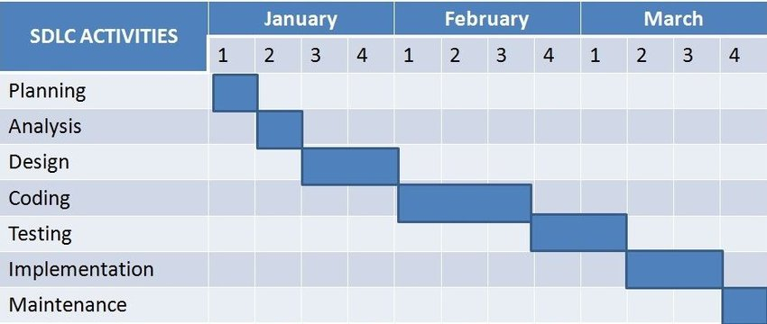
September

Slide 14


